Slide 1
Chapter 6
Procedures and Functions

Slide 2
Procedures and Functions
Break code down into small, manageable pieces
Collection of statements that performs a specific task ex: Sound1.play
Must have unique names
Often get confused……
Procedures have no return value
Functions have a return value

Slide 3
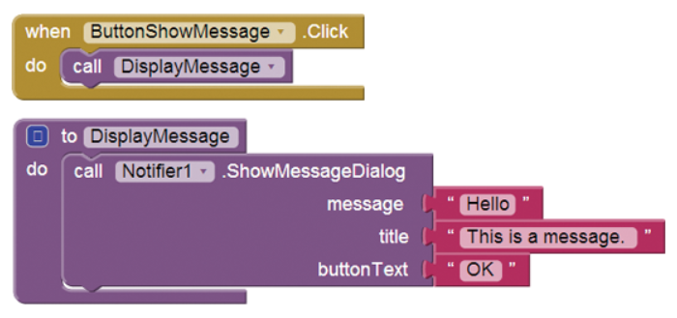
Display Message Example

Slide 4
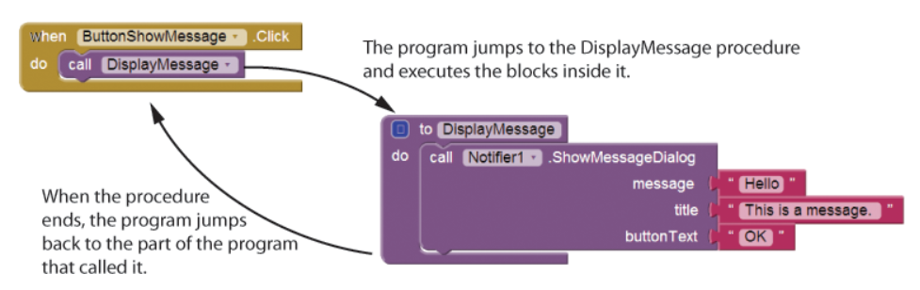
Order of Execution

Slide 5
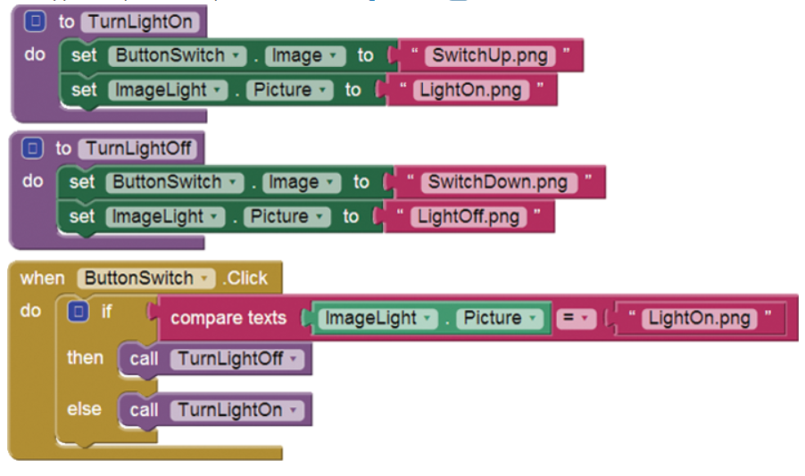
Light Switch Example

Slide 6
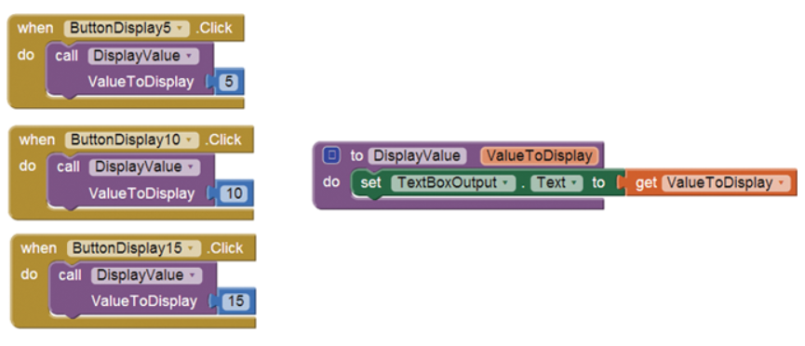
Arguments vs Parameters

Slide 7
Button Display Example (Passing Arguments)

Slide 8
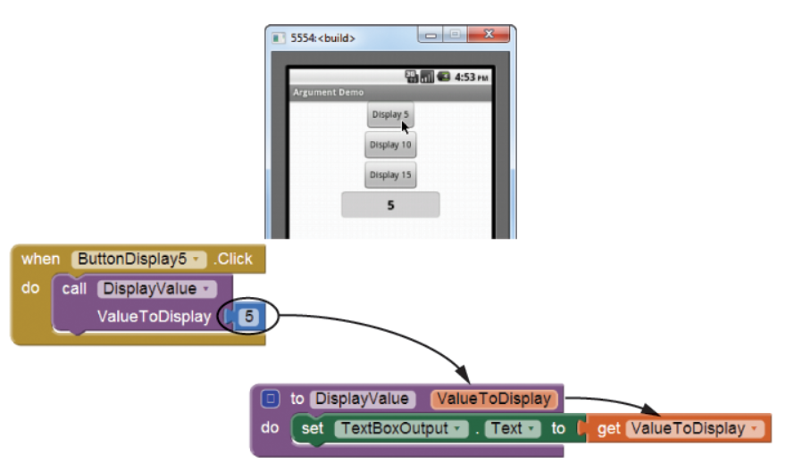
Order of Execution

Slide 9
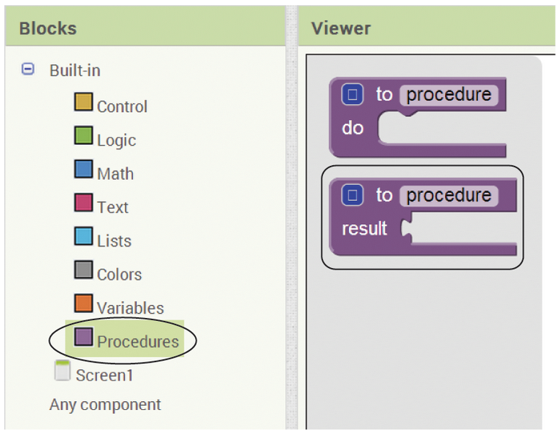

Returning Values From Procedures

Slide 10
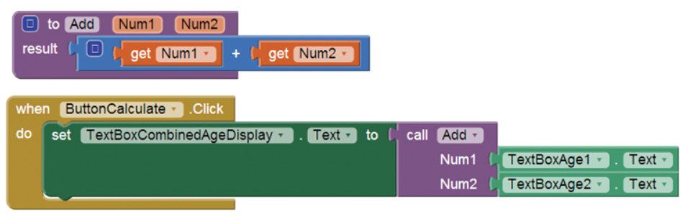
Value Returning Function

Slide 11
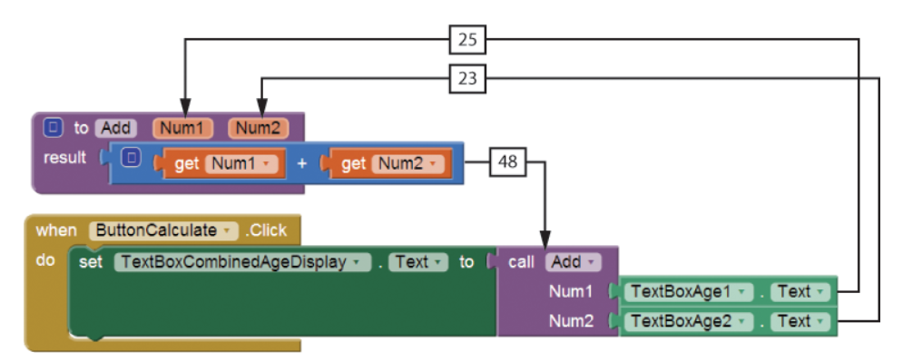
Order of Execution

Slide 12
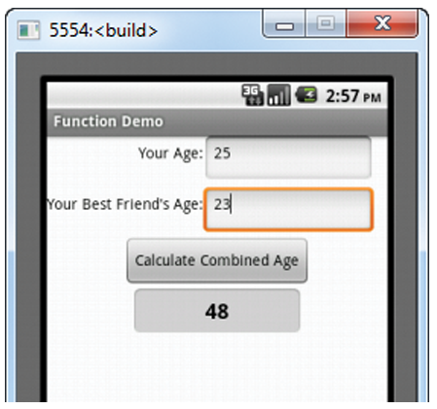
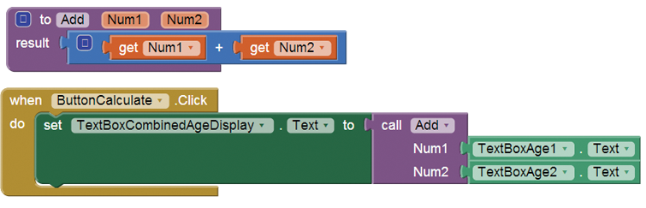
Combined Age App

Slide 13
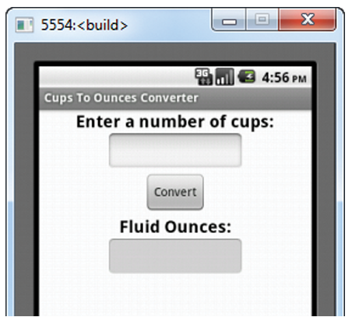
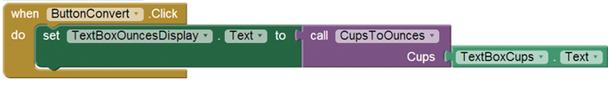
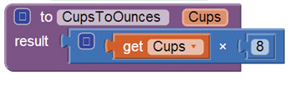
Cups To Ounces
video note

Slide 14
Final Project
Pick a project you would like to work on for your final project.

